Slide 1

A Data Mining Approach to Air Pollution Analysis and Sustainable Policy Development
Work By: Akash Vishwakarma, Himanshu Borole, Shantanu Jhaveri, Vaibhav Rungta
Dr. Bistra Dilkina, PhD
Professor & Director of USC Center for AI in Society

Slide 2
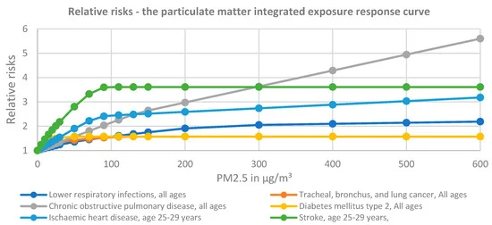



Motivation:
Air pollution stands as a substantial factor in global mortality.
The World Health Organization (WHO) estimates that roughly 7 million premature deaths annually result from diseases related to air pollution.
Compounding effects of multiple pollutants can better a holistic view by integrating data from various pollutants to assess environmental and health impacts
This issue strongly aligns with several Sustainable Development Goals (SDGs), particularly SDG 11 (sustainable cities and communities), SDG 3 (health), and SDG 13 (climate action).
Notes:
This crop yield prediction research seems well aligned with the following UN Sustainable Development Goals (SDGs):
Goal 2 - Zero Hunger: Accurate and timely crop yield forecasts enable better food distribution and famine prevention, helping to eliminate hunger.
Goal 12 - Responsible Consumption and Production: Using publicly available remote sensing data provides a more sustainable approach than resource-intensive field surveys.
Goal 13 - Climate Action: Better crop yield predictions allow for assessing and addressing the impacts of climate change on agriculture.
Specifically, this work contributes to SDG Target 2.1: "By 2030, end hunger and ensure access by all people, in particular the poor and people in vulnerable situations, including infants, to safe, nutritious and sufficient food all year round."

Slide 3
Problem
The problem at hand is to analyze and understand the diverse and changing patterns of air pollutant emissions across regions, particularly in developing countries undergoing rapid industrialization, spanning from 1970 to 2018, in order to inform targeted intervention strategies for regions with significant pollution challenges.

Slide 4
Our Plan
Combining emissions data from various sources
Apply k-means clustering on preprocessed data
Analysing clusters revealing underlying patterns and trends
Provide region specific actionable insights

Slide 5
Problem: Related Work
Smith and Rodriguez (2020): analyzed the impact of urbanization and the resultant vehicular emissions on the concentrations of NOx and CO.
Modeled histogram analysis
Hoffman et al. (2013): Land mass masking used for spatio-temporal analysis. Additionally, the interplay between agricultural emissions, particularly of methane and ammonia, and air quality was examined by Li and Huang (2022)
Zhang et al. (2023) presented a holistic view by integrating data from various pollutants to assess environmental and health impacts.

Slide 6
Dataset Overview
Datasource: The Emissions Database for Global Atmospheric Research
The full dataset includes nine significant pollutants :
PM2.5, PM10, CO, NOx, NMVOCs, CH4, NH3, SO2, BC, and OC
The pollutants are examined in depth spatially and temporally
Pollutants are contained within emission contributor
i.e. agriculture, burning, aviation, etc

Slide 7
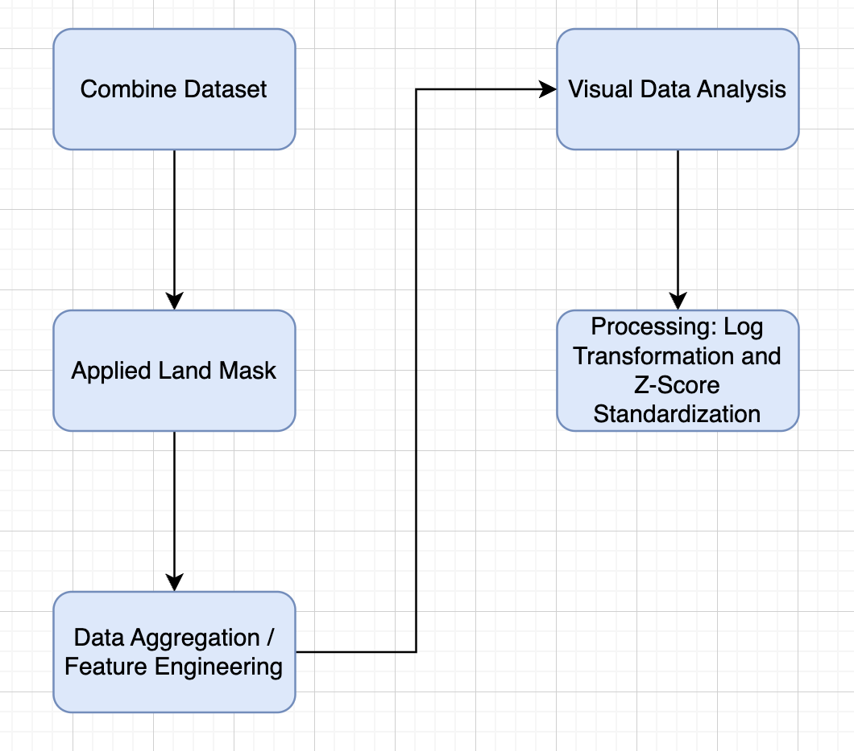
Data
Preprocessing
Pipeline

Slide 8
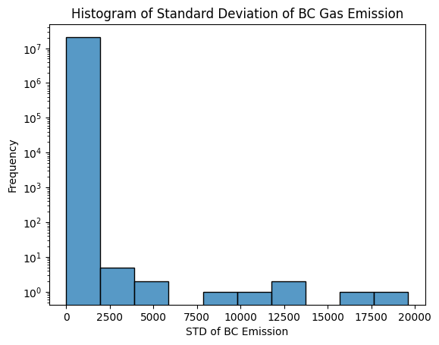
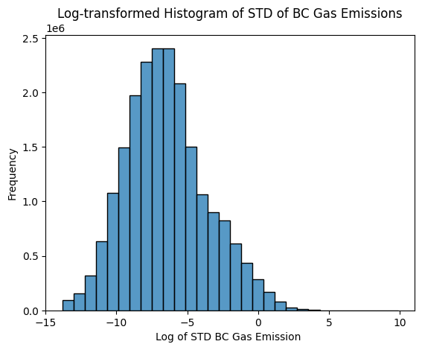
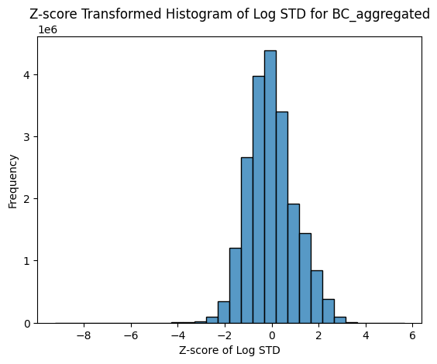
Data Preprocessing
Each data point is characterized by 18 features, which include the mean and standard deviation values for nine distinct pollutants, aggregated over ten-year periods.
Each feature is log transformed due to its heavy positive skewness and standardized using Z-score for better clustering.

Slide 9
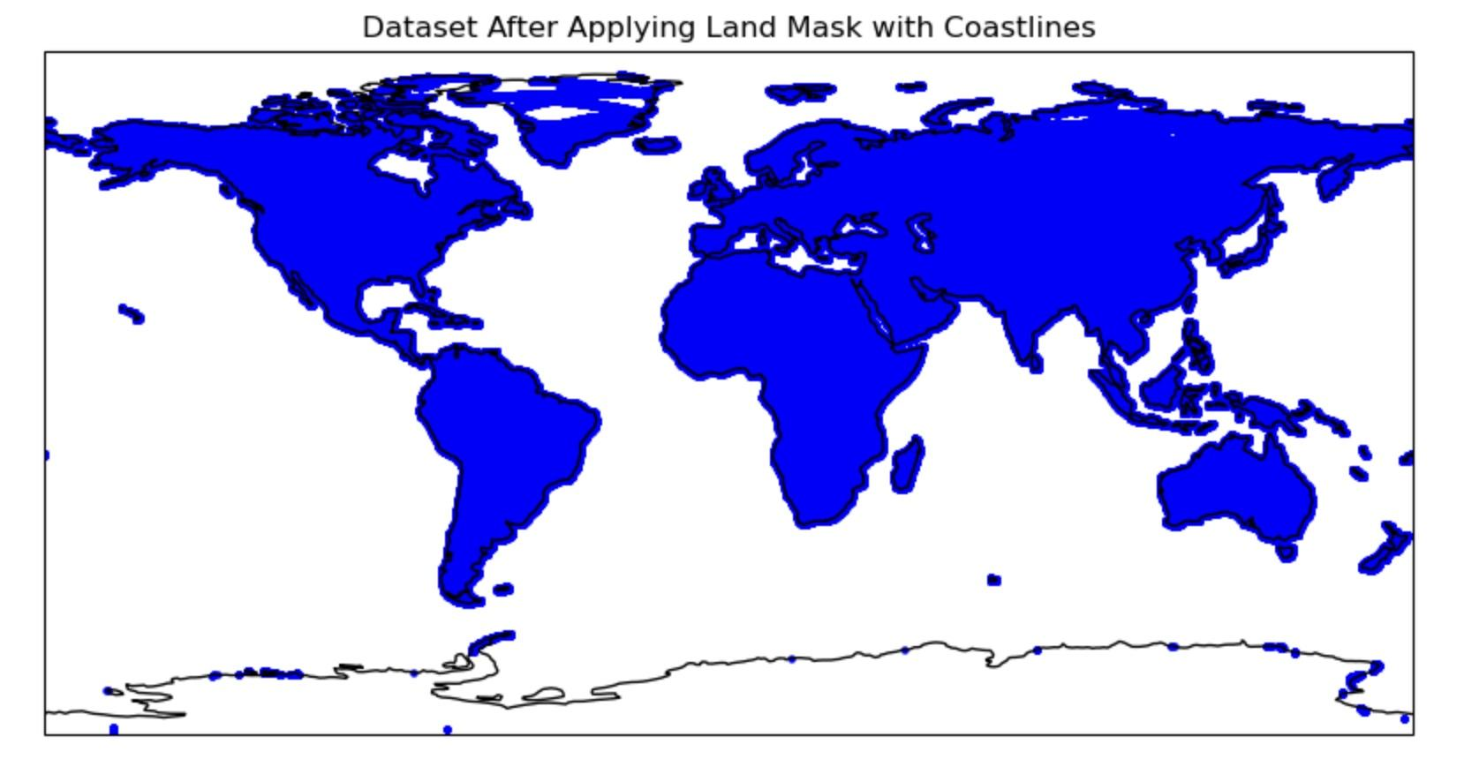
Application of Land Mask in Spatial Analysis
Background:
In our study, we used a geospatial technique called 'land masking' to refine our dataset.
Land Mask Characteristics:
Resolution: Our 110-meter accuracy land mask balances precision and efficiency for large-scale environmental studies.
Source: Natural Earth Data
Methodology:
Spatial Join: We conducted a spatial join between our primary dataset (0.1x0.1-degree grid) and the land mask using Python geopandas library.
Filtering: This step removed data points not intersecting with terrestrial regions, ensuring our analysis relies solely on land-based data.

Slide 10
Implications of Preprocessing
Accuracy:
By applying a land mask, we significantly enhanced the accuracy of our environmental analysis. This method effectively removes marine and other non-terrestrial data points, which could otherwise skew results or lead to incorrect interpretations in a land-focused study.
Opting for a 110m resolution land mask facilitated a more efficient processing time compared to higher-resolution alternatives, without compromising the integrity of our analysis for the scale at which we operated.
Efficiency:

Slide 11
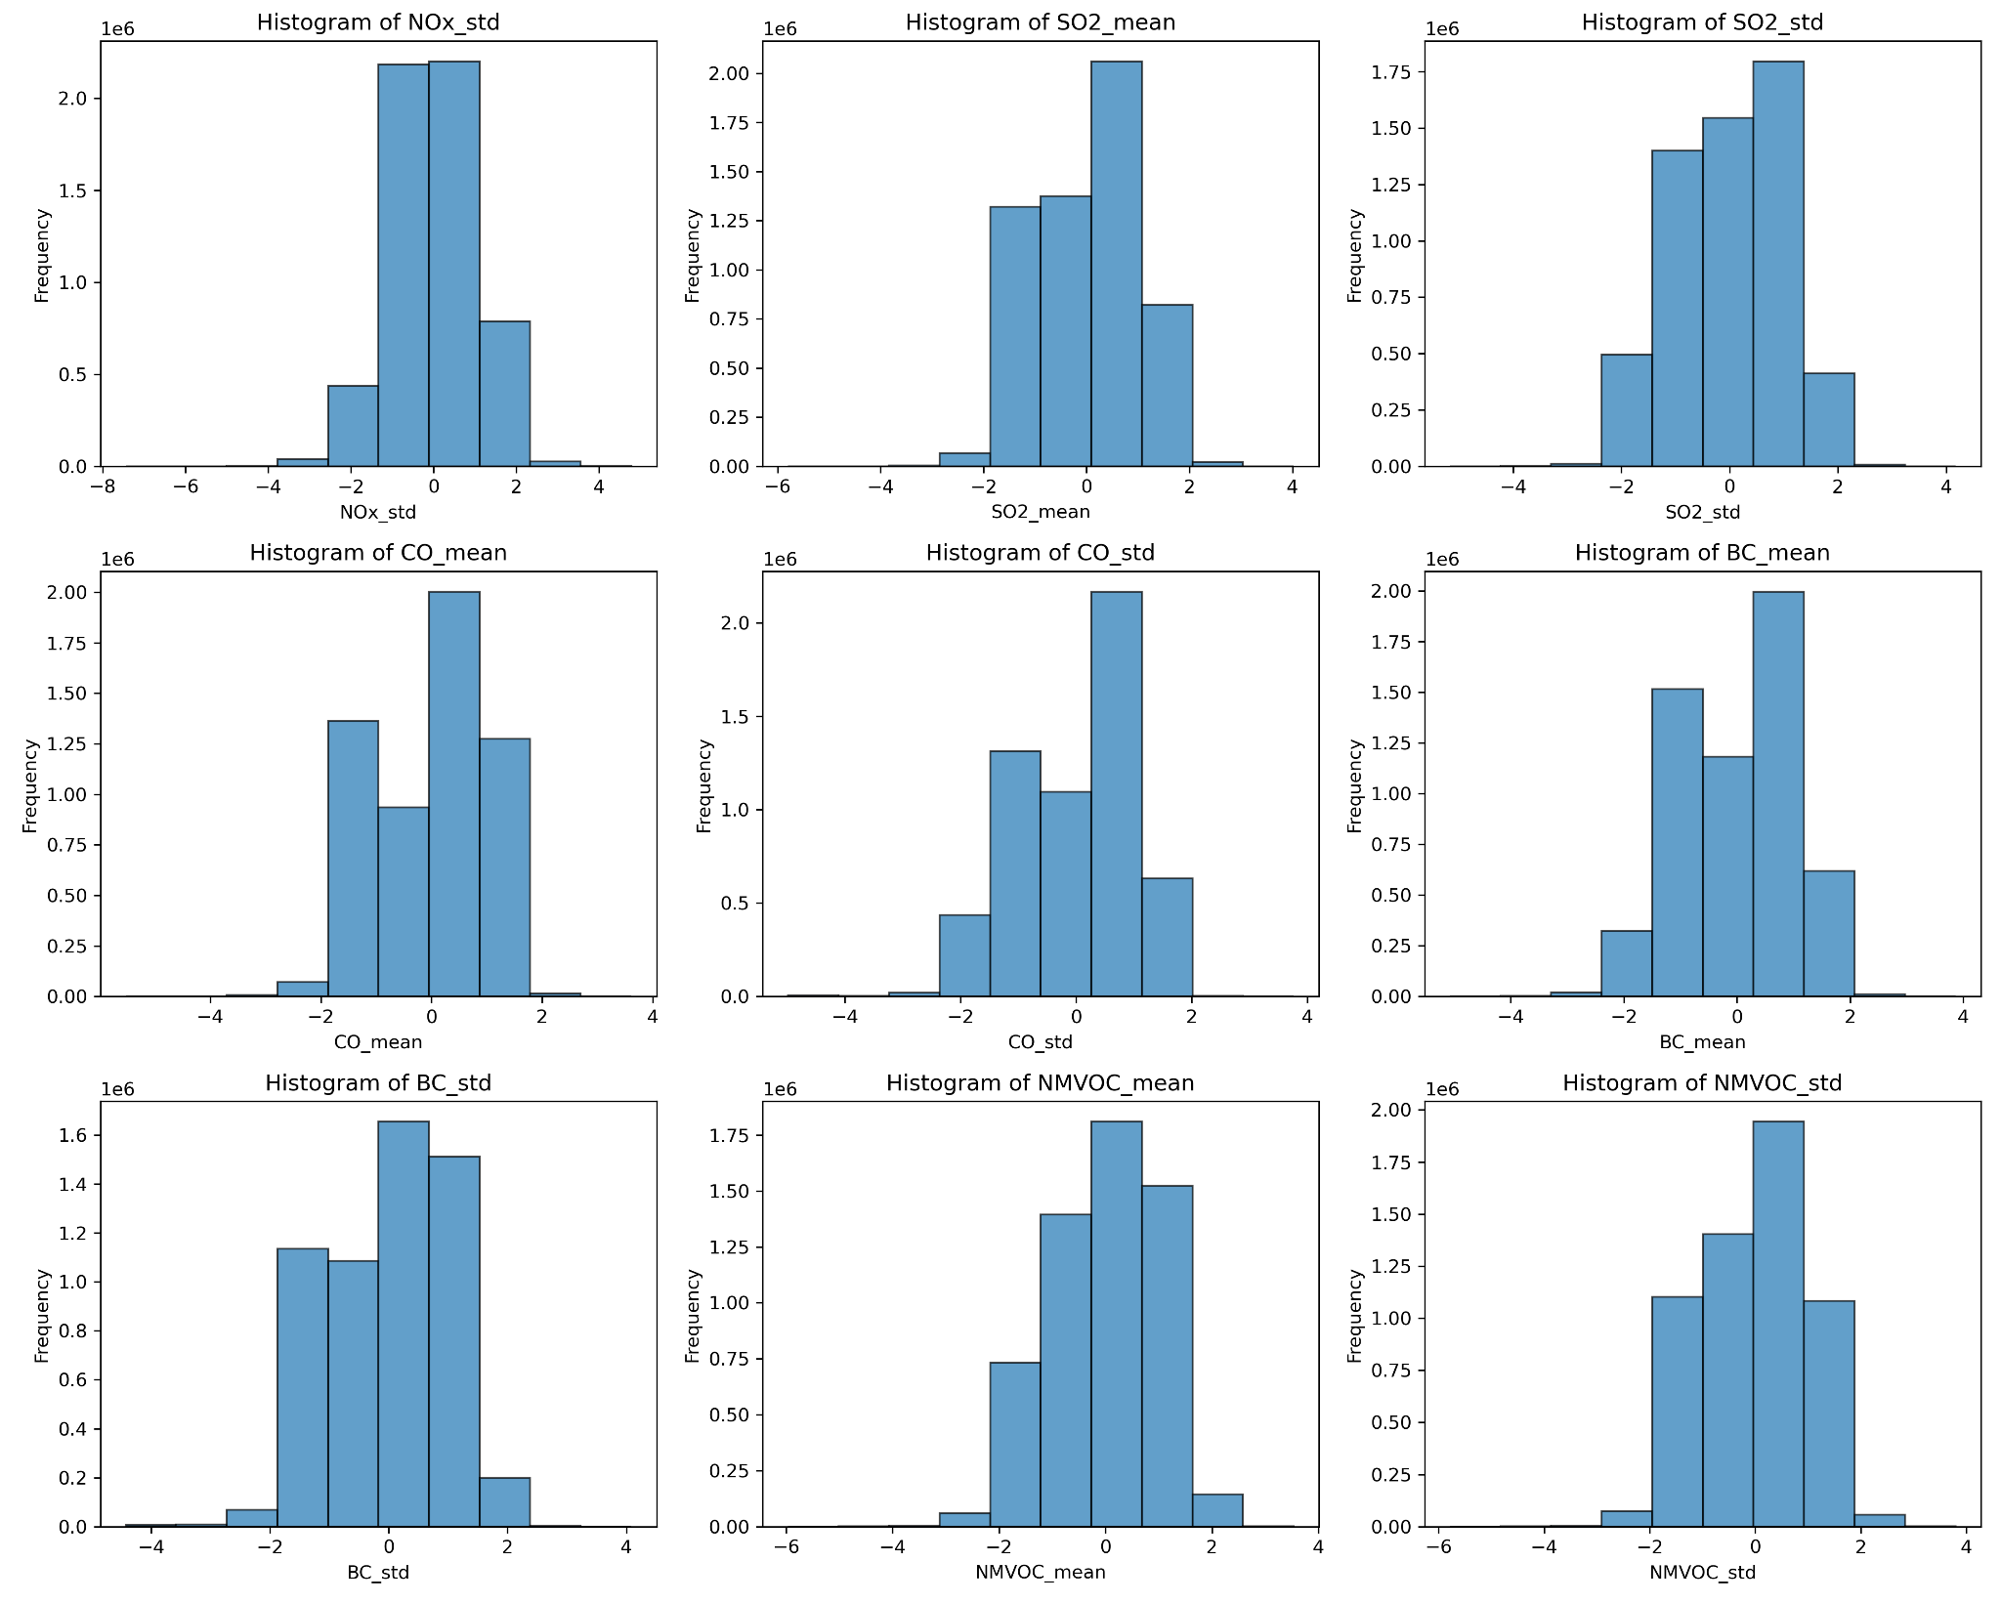
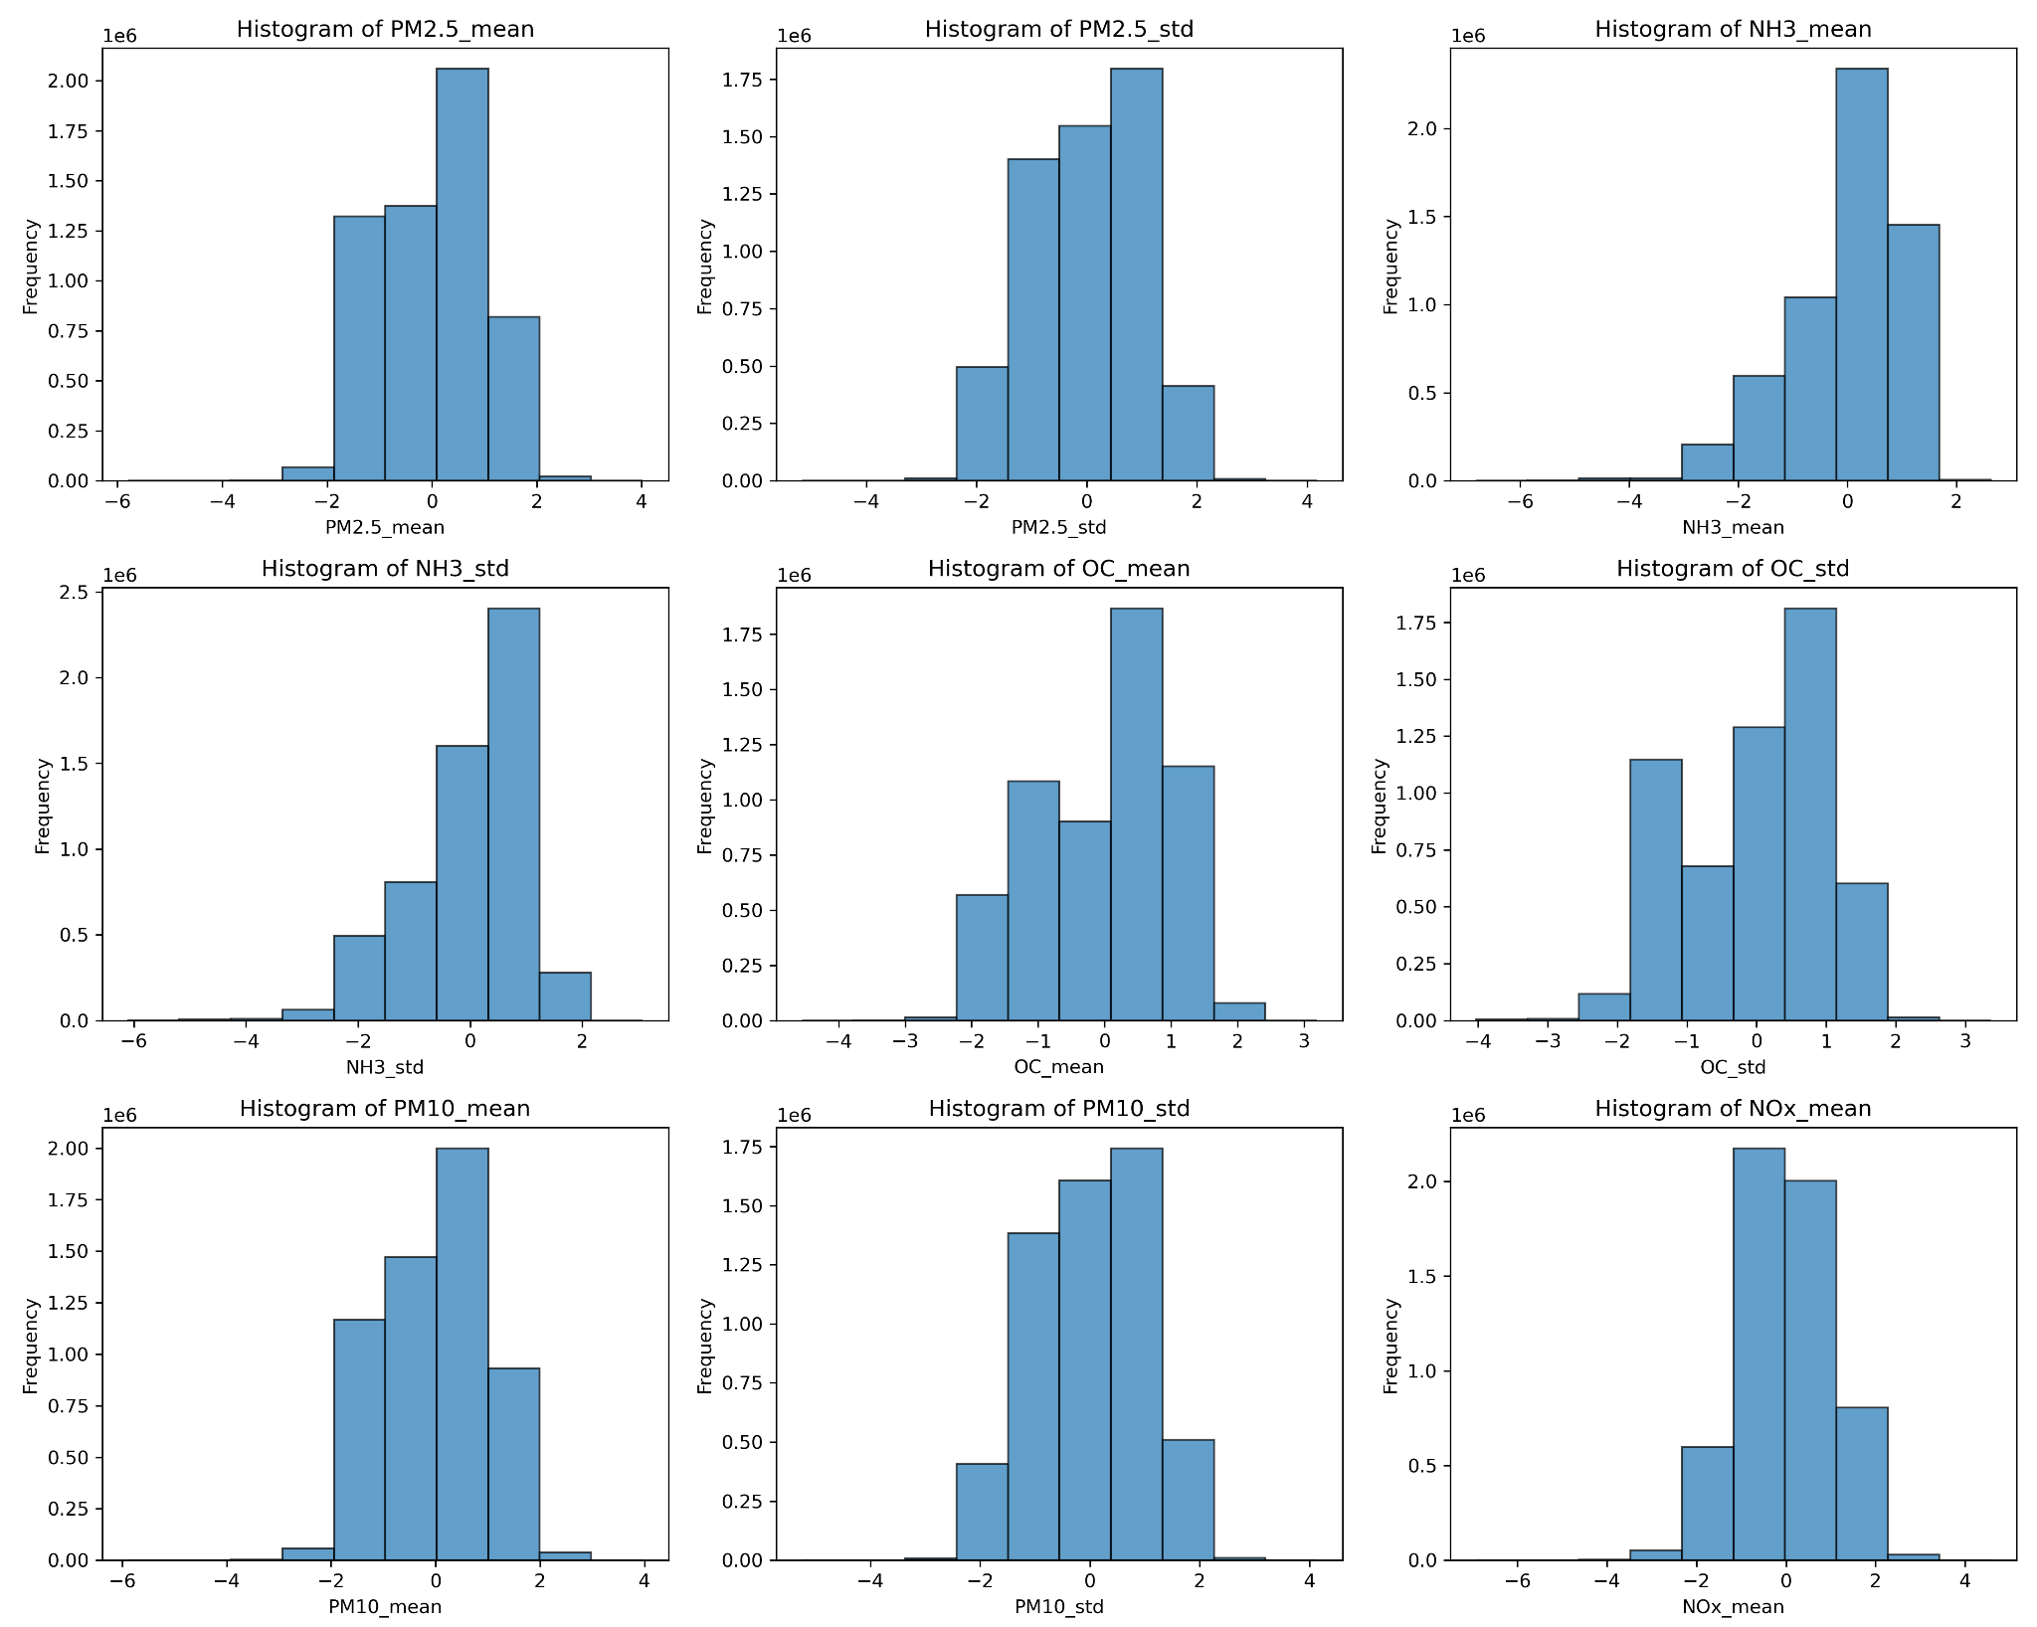
Features: Histogram Analysis

Slide 12
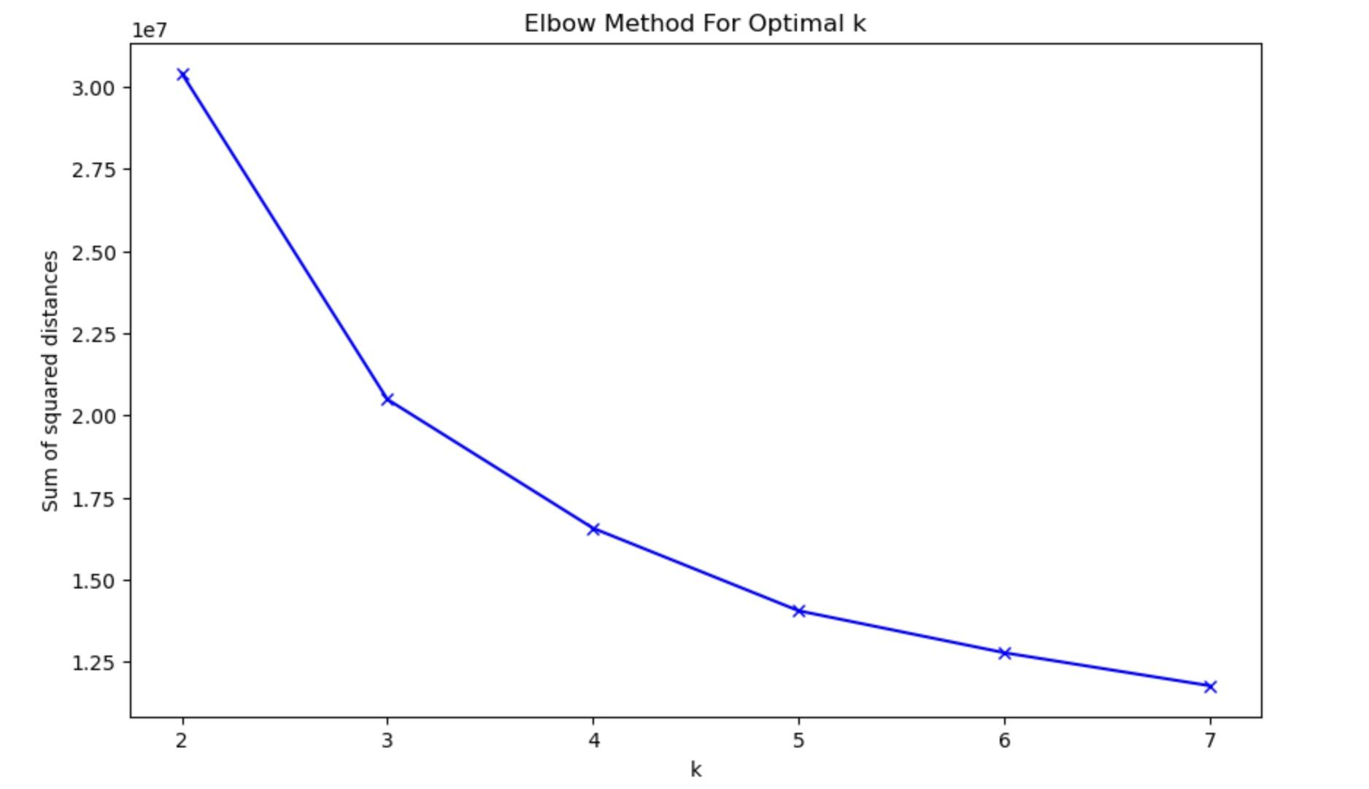
Elbow Method
The Elbow Method graph identifies k=3 as the optimal number of clusters for our dataset
Beyond this point, the reduction in the sum of squared distances begins to level off, indicating diminishing returns on the definition of additional clusters.

Slide 13
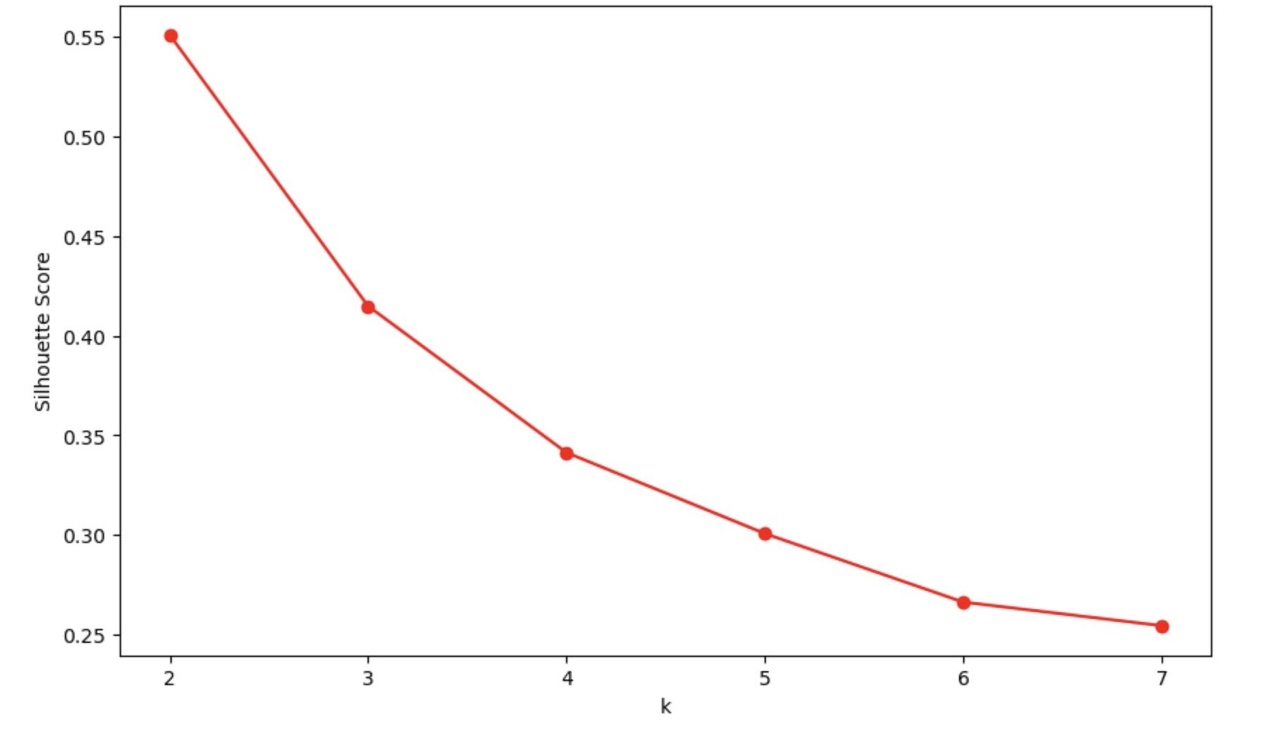
Silhouette Score
Due to the large dataset size, we employed random sampling.
The silhouette analysis indicates that a two-cluster solution is optimal, with a moderate score at three clusters suggesting a fair but less distinct separation of data points.
Silhouette Score k = 2 to 7

Slide 14
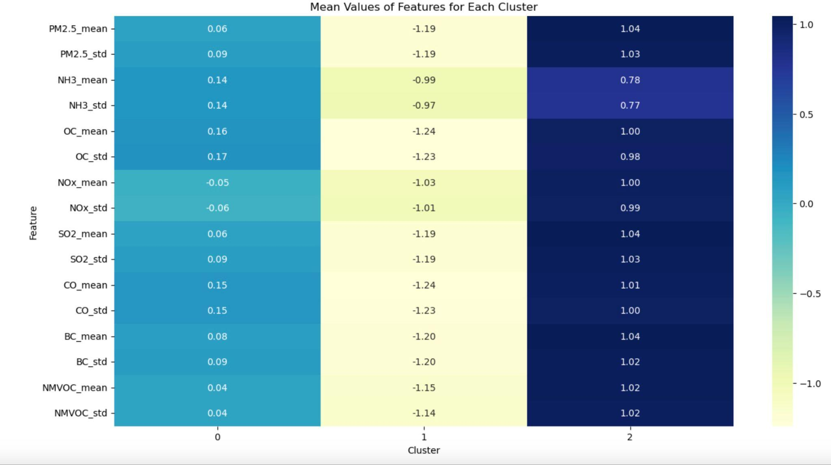
Mean Values of Features for k=3

Slide 15
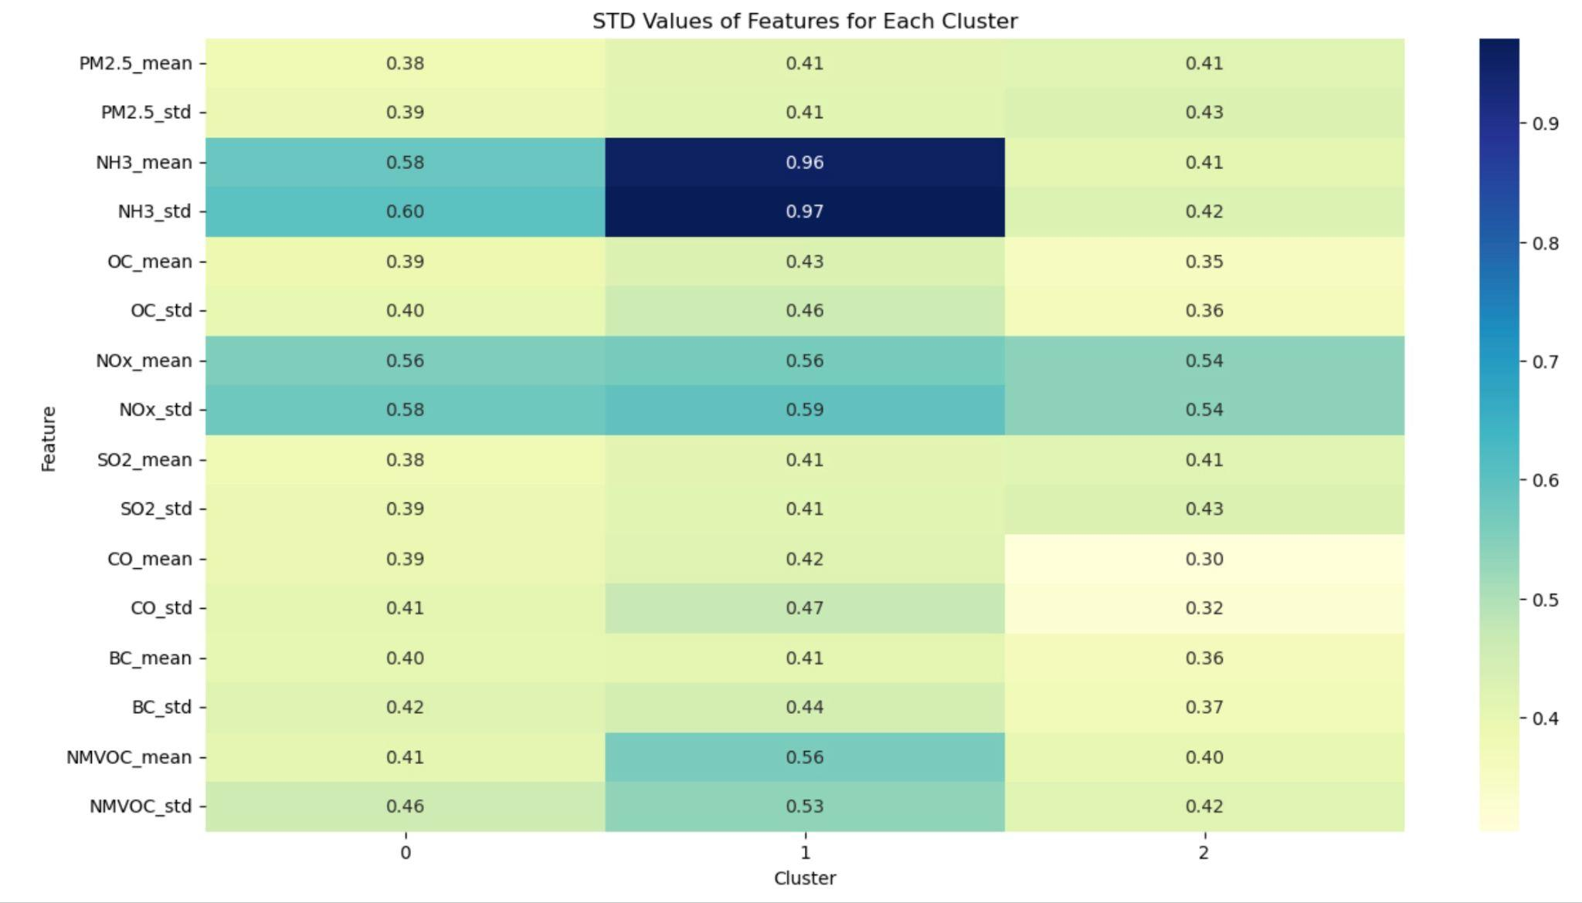
Standard Deviation of Features for k=3

Slide 16
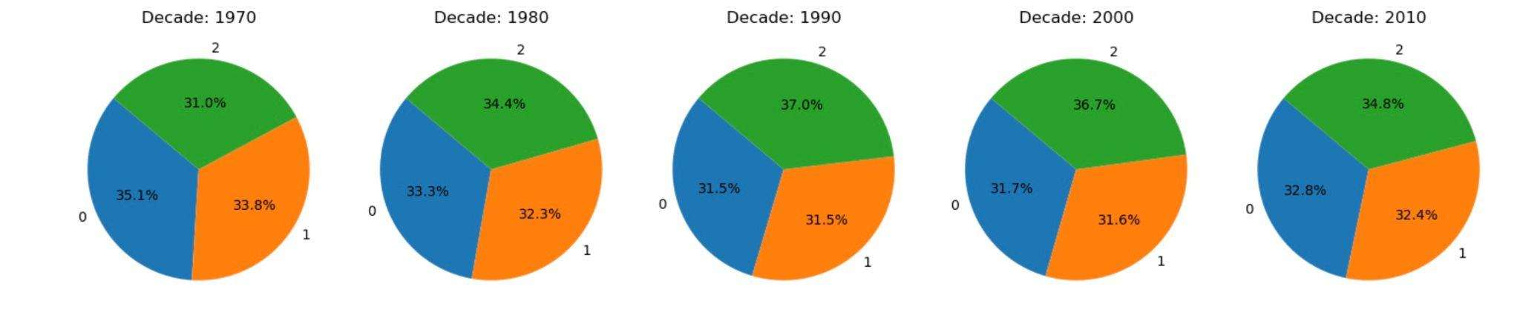
Cluster Distribution For Each Decade
Clusters k=3

Slide 17
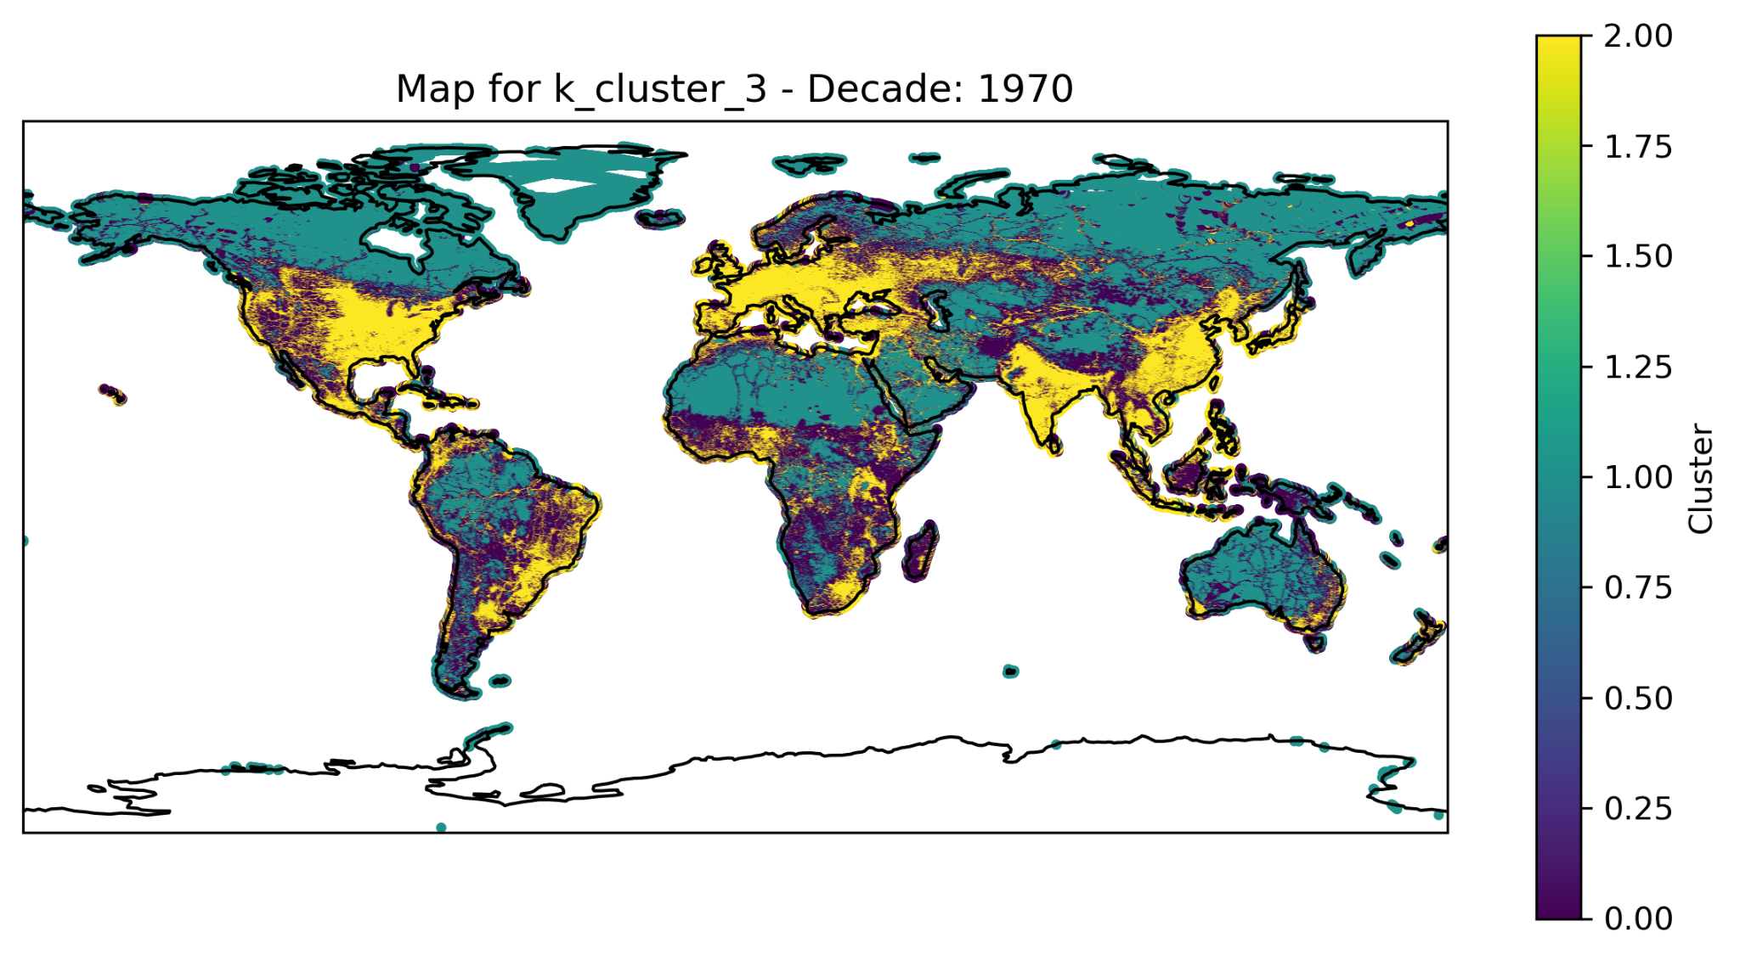
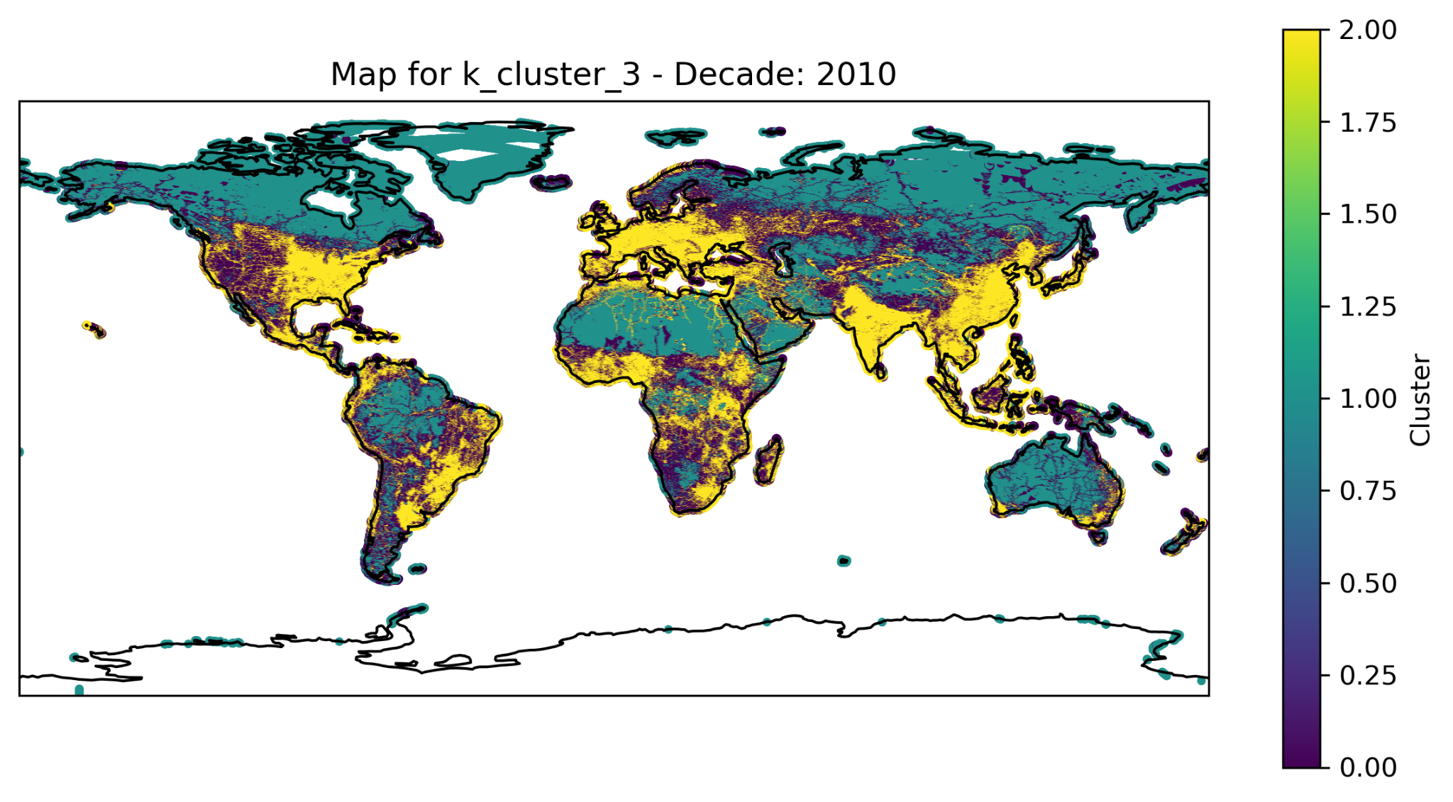
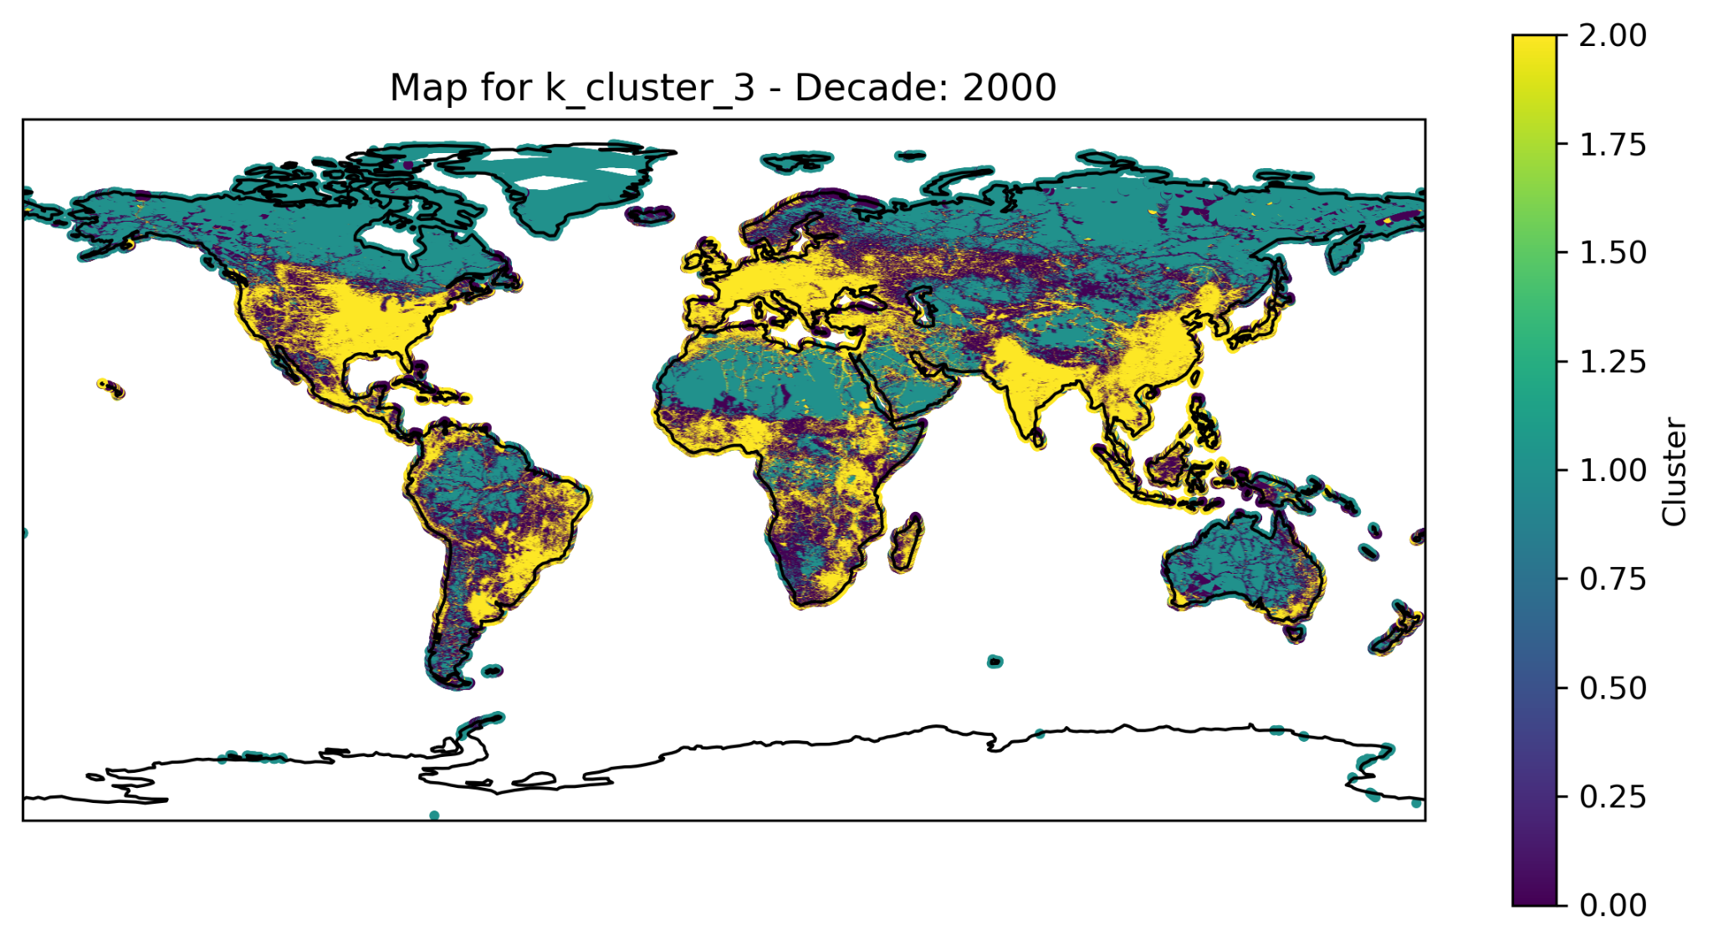
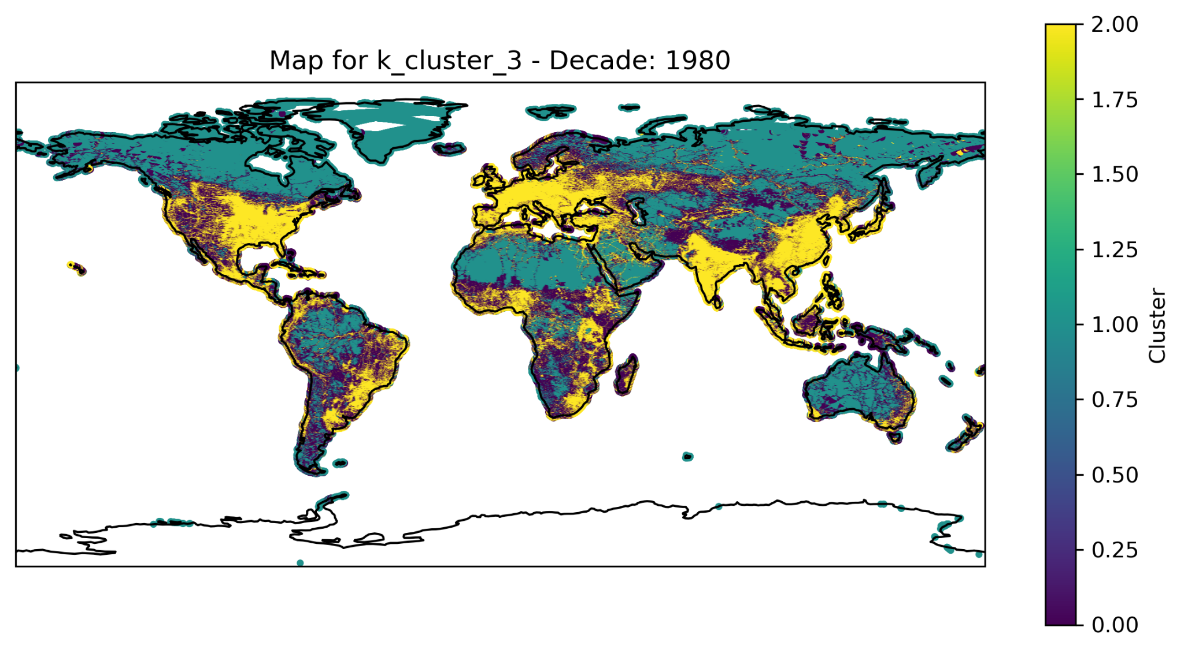
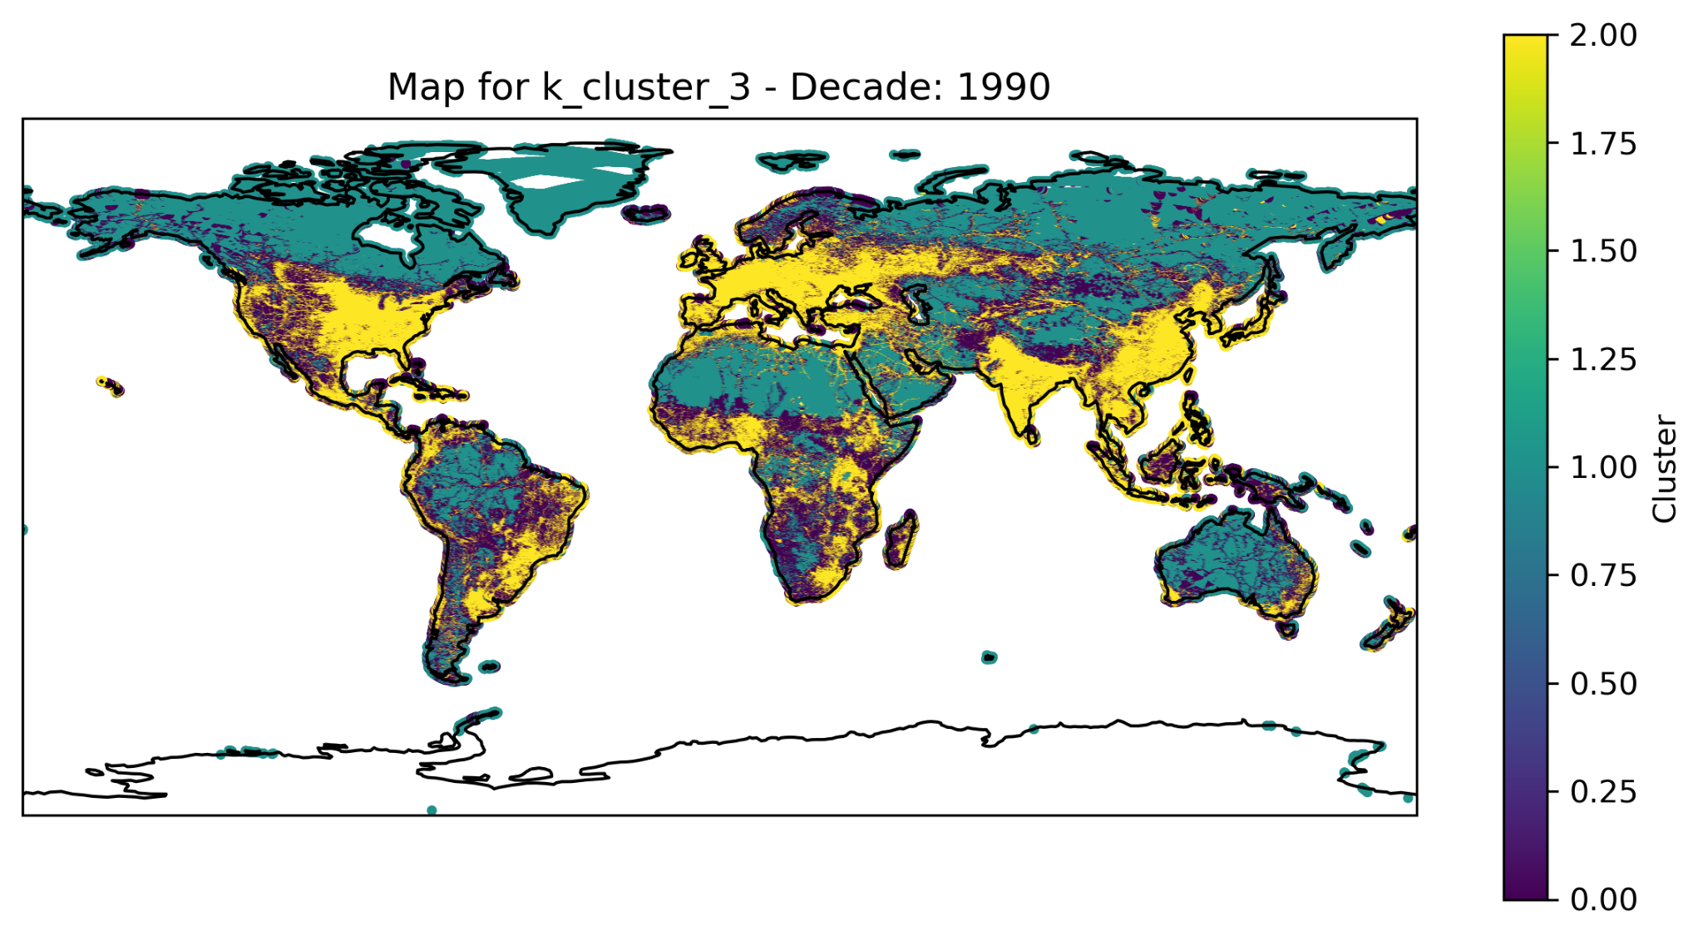

Slide 18
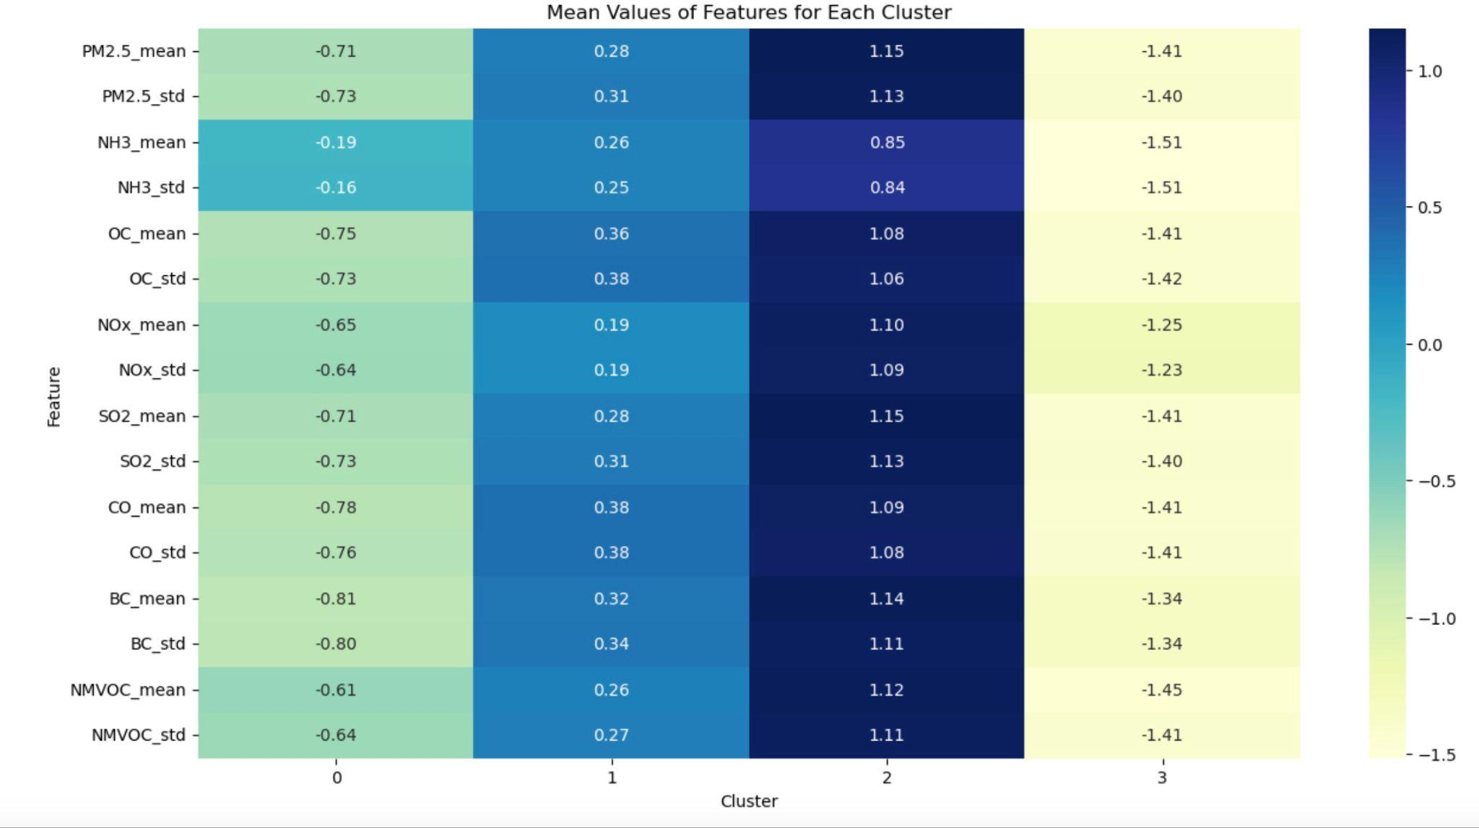
Mean Values of Features for k=4

Slide 19
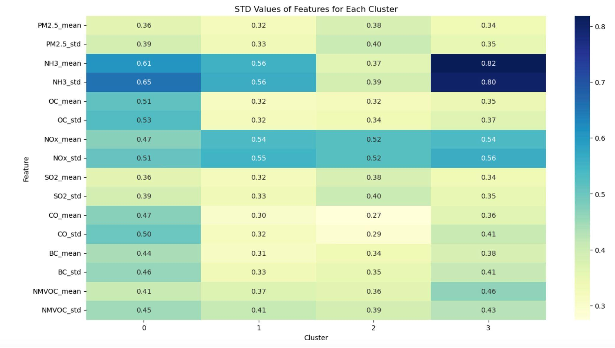
Standard Deviation of Features for k=4

Slide 20
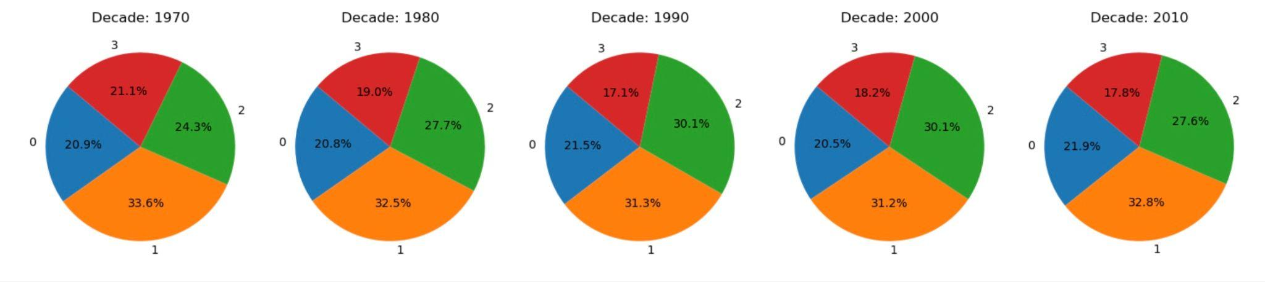
Cluster Distribution For Each Decade
Clusters k=4

Slide 21
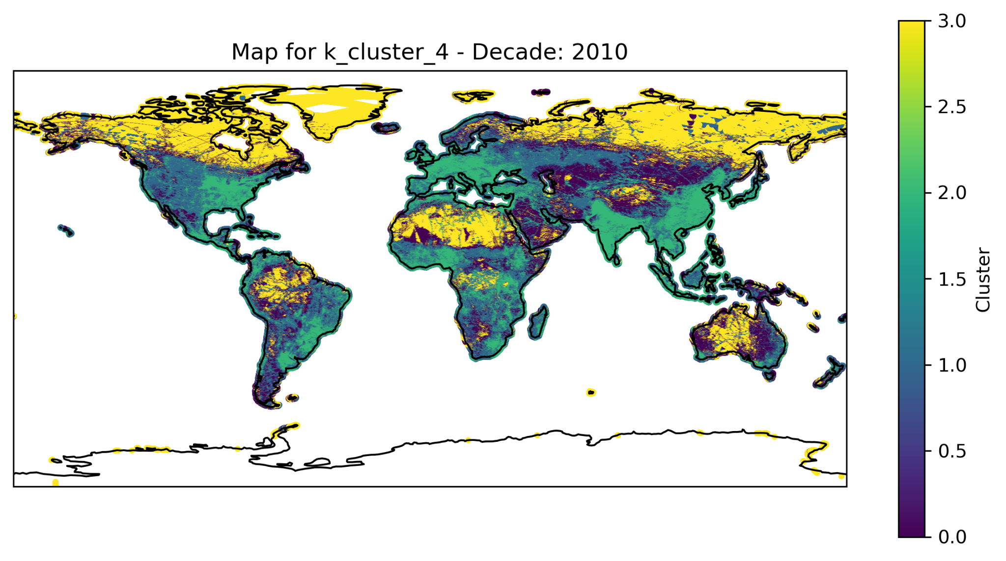
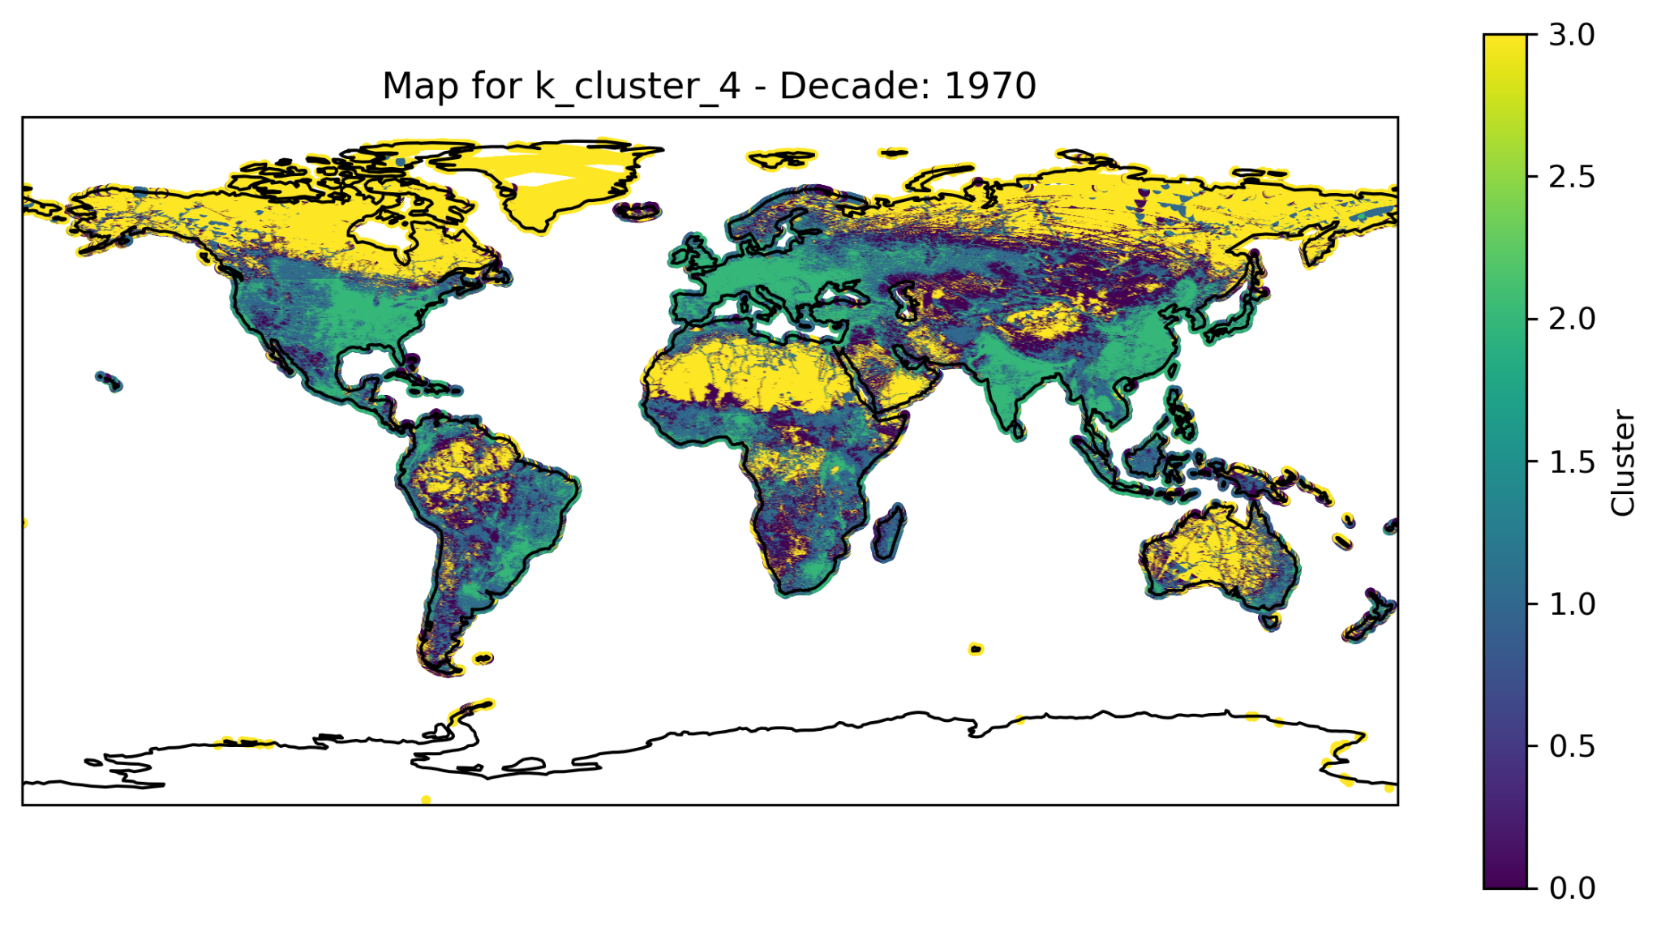
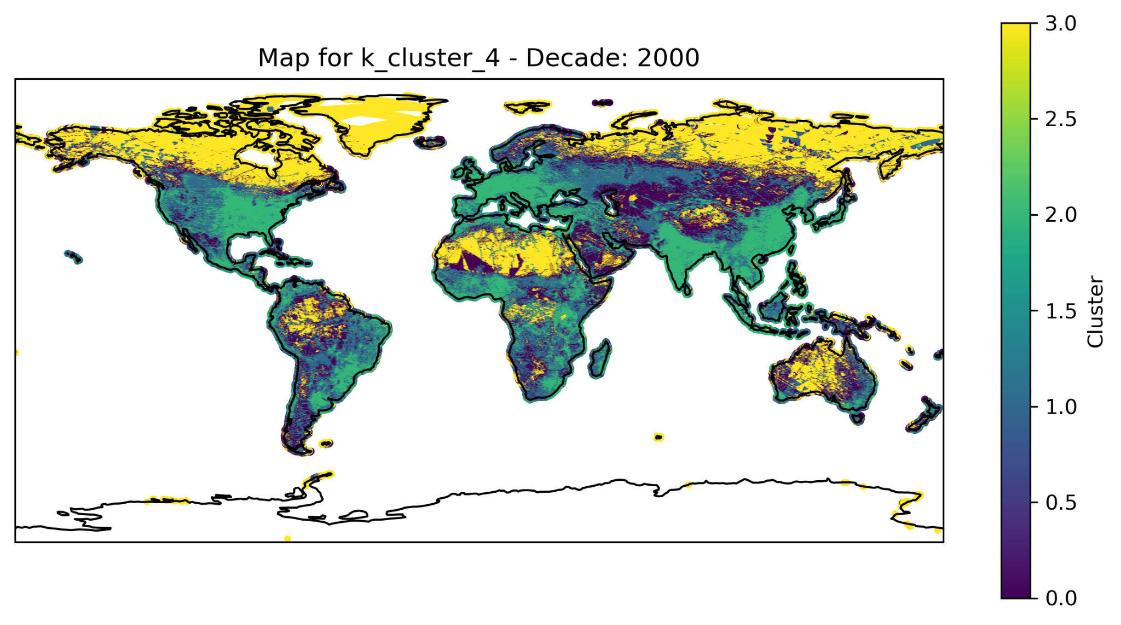
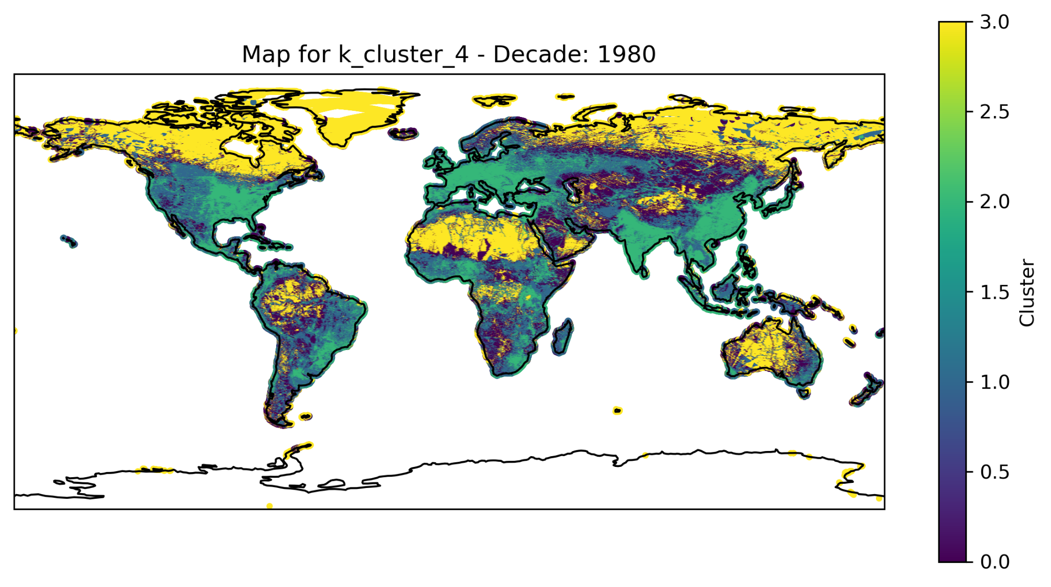
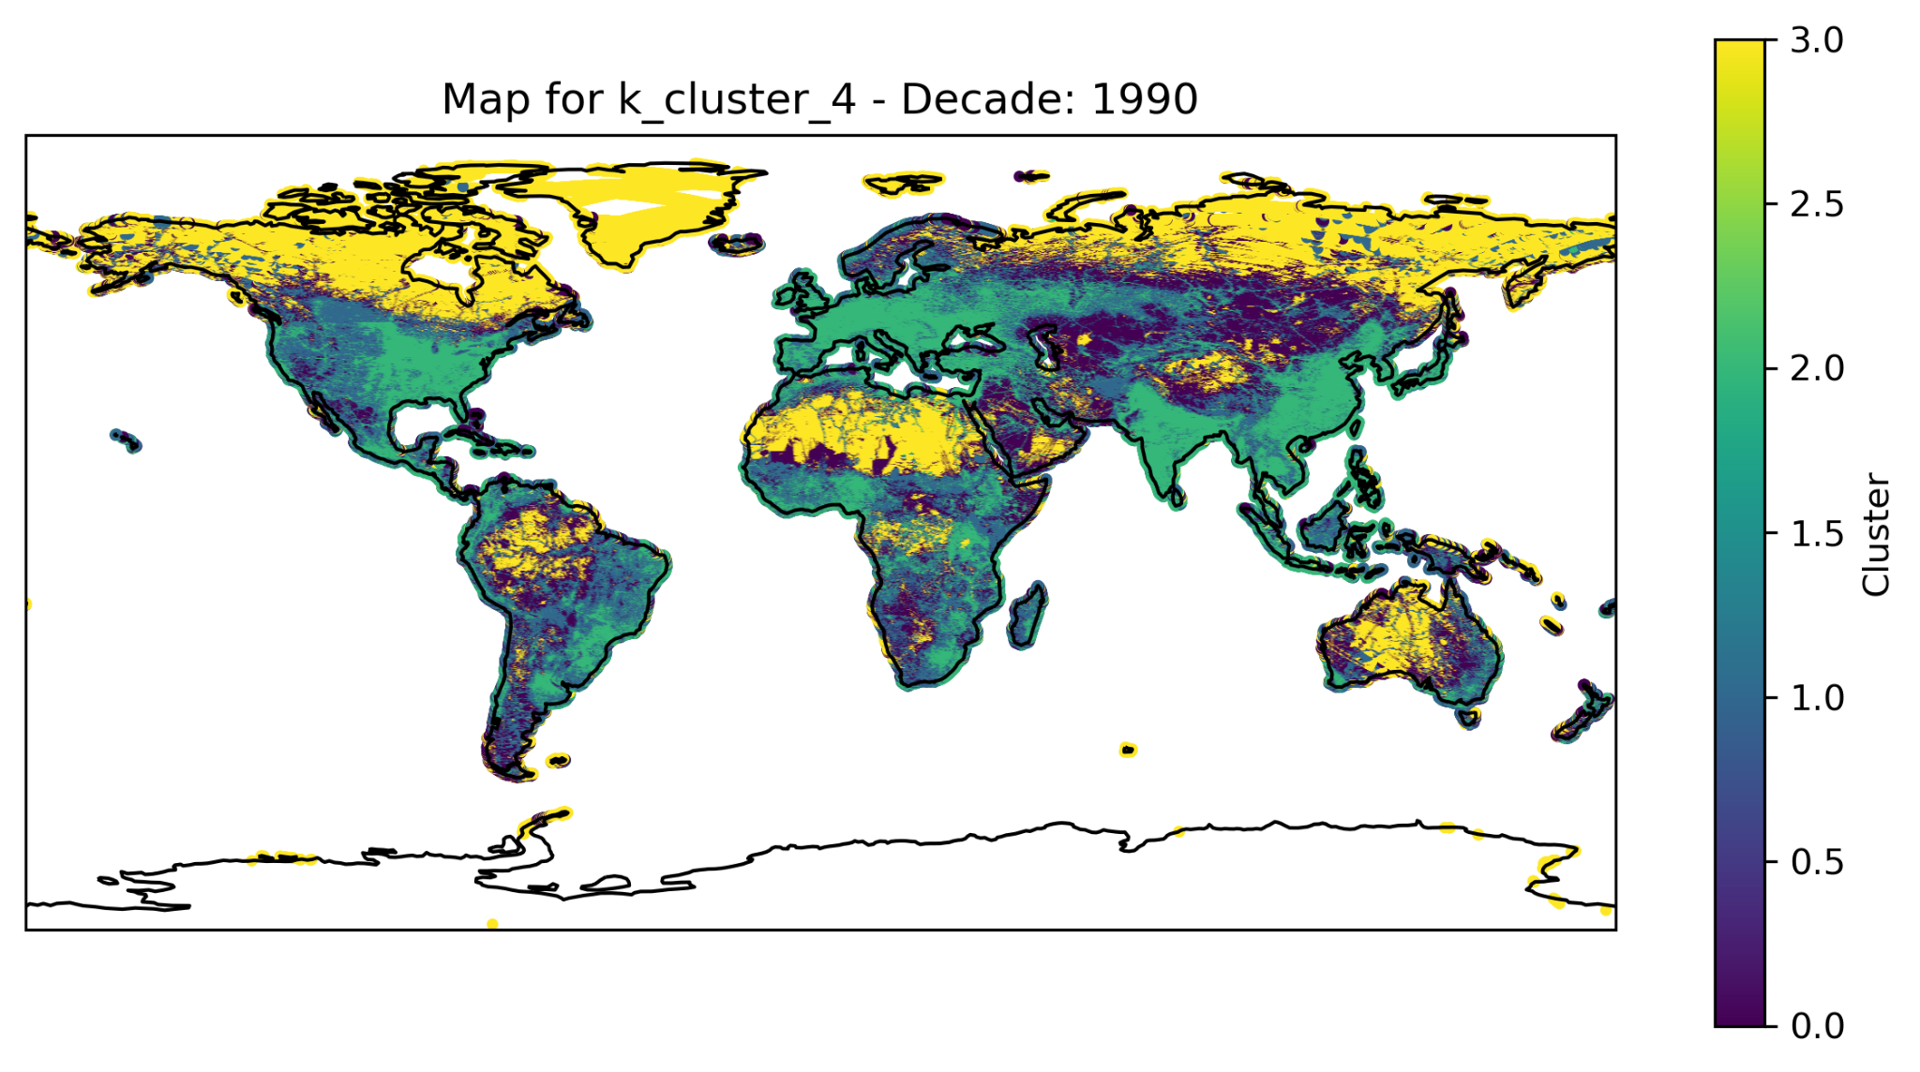

Slide 22
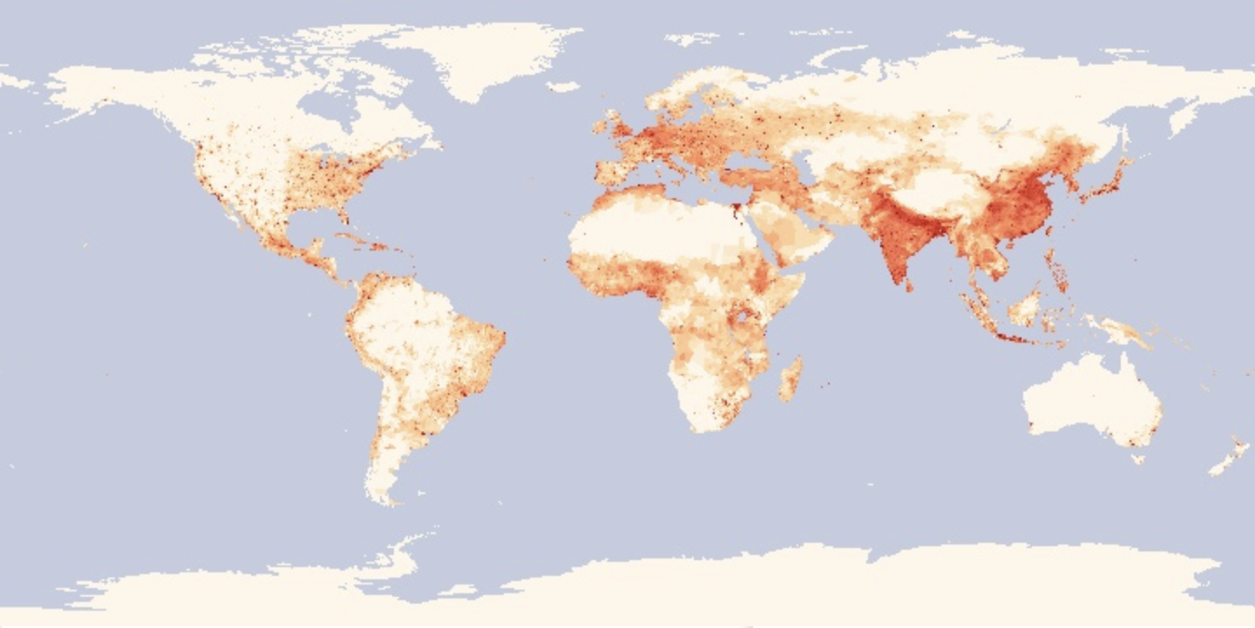
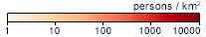
Population Density 2010

Slide 23
Limitations
Future Scope
As we work with grids defined by degrees, it's important to note that the actual size of these grids varies depending on their proximity to the equator or the poles. Hence generic treatment of all grid points may not be fair.
Conduct this study with aggregation of emissions across sectors rather than by gas type. As gas type is highly correlated it does not allow for analysis of complex relationships.
This is also motivated by the fact that distinct transportation emission bands are visible over the clustered maps.

Slide 24
Thank you!

